Slide 1
Overview of the New Vehicle and Engine Exhaust Emission and Fuel Quality Standards in the United States
Cleaner Trucks,
Cleaner Fuel, Cleaner Air
Mary T. Manners
U.S. EPA Office of Transportation and Air Quality

Slide 2
Presentation Overview
Key elements of the Phase 2 rule
Highway diesel NOx and PM standards
Air quality benefits of the HD 2007 program
Highway diesel fuel standards
  80/20 Temporary Compliance Option
  Hardship Provisions
Refinery modifications and technology
Interaction with other programs
The road ahead

Slide 3
Key Elements of the Phase 2 Rule
January 18: Final Rule Published
National program for heavy-duty vehicles
PM standards in 2007
NOx & HC standards phasing in 2007-2010
15 ppm sulfur cap for highway diesel fuel by mid-2006
Voluntary compliance flexibilities for refiners

Slide 4

Highway HDVs: Phase 2
2007 and later Highway Heavy-Duty Engine and Vehicle Standards & Diesel Fuel Sulfur Control
Regulate vehicle and fuel as a system
Low sulfur fuel enables advanced aftertreatment technology
90%+ emission reductions in NOx & PM
Low sulfur diesel fuel also benefits design of light-duty diesels for Tier 2 standards

Slide 5
Highway Diesel NOx Standards
g/hp-hr
12
1985
~ uncontrolled levels
10
NOx aftertreatment-based
0.2 g/bhp-hr
~90% reduction
8
1990
6
1991
1998
4
2004
2
2007
0

Slide 6
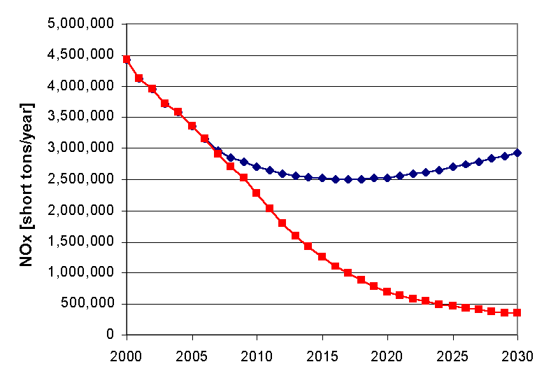
NOx Emissions
Nationwide Heavy-duty Vehicle NOx (million tons / year)
without new standards
with new standards
Calendar Year

Slide 7
Highway Diesel PM Standards
g/hp-hr
0.7
1988
0.6
Catalyzed PM Trap based
0.01 g/bhp-hr
90% reduction
0.5
0.4
0.3
1991
0.2
1994
truck
0.1
bus
2007
0

Slide 8
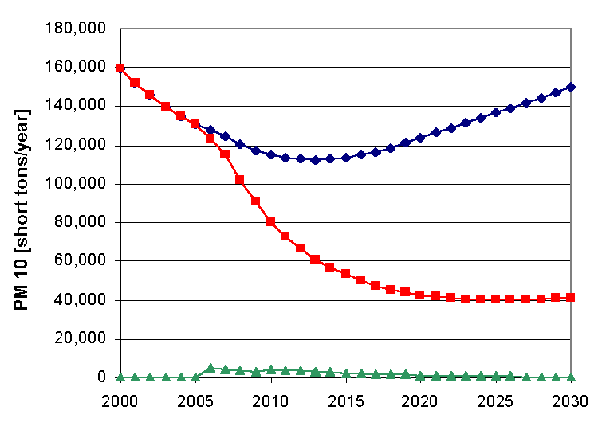
PM Emissions
Nationwide Heavy-duty Vehicle PM (thousand tons / year)
without new standards
with new standards
Calendar Year

Slide 9





ppm sulfur
1500-3000
typical nonroad diesel
Where things stand:
Sulfur in
Diesel Fuel
Canada, Mexico,
Japan too
500
maximum highway diesel
(& California nonroad diesel )
~350
typical gasoline
and diesel now
~130
typical California diesel
50
Europe 2005 diesel maximum
15
U.S. EPA - 2006
10
Swedish and UK city fuel
<2
ARCO EC-D (first batch)

Slide 10

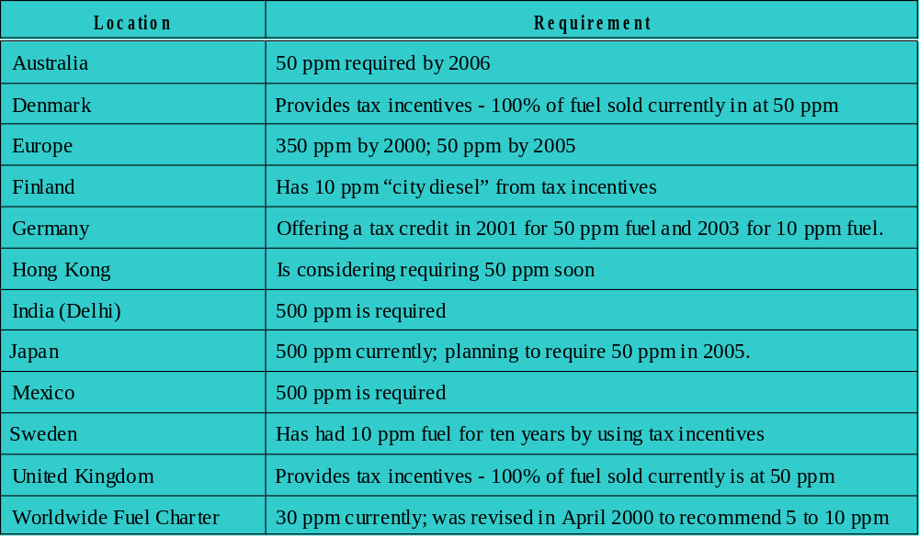
International Diesel Fuel
Quality Standards

Slide 11

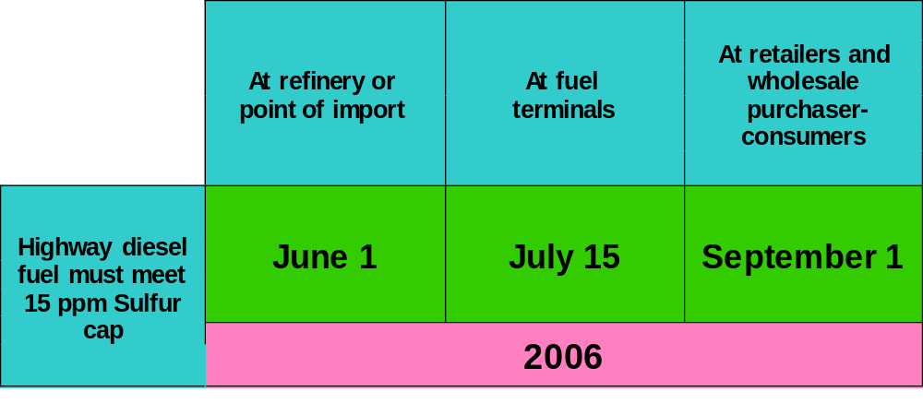
Highway Diesel
Fuel Program

Slide 12
80/20
Temporary Compliance Option
Refinery standard: 80% 15 ppm and up to 20% 500 ppm diesel fuel in 2006 (until 2010)
PADD-restricted ABT program
  Nearly half of all highway diesel refineries can delay investment by 4 years
  Extra time allows refineries to select the best performing technology based on at least 2 years actual experience
  Provides more time for new technologies to develop

Slide 13
Hardship Provisions
Small refiner provisions
  500 ppm Option
  Small Refiner Credit Option
  Gasoline/Diesel Compliance Date Option
Geographic Phase-in Area provision
General hardship provisions
  Extreme unforeseen circumstances (e.g., natural disaster)
  Extreme hardship circumstances (e.g., financial hardship)

Slide 14
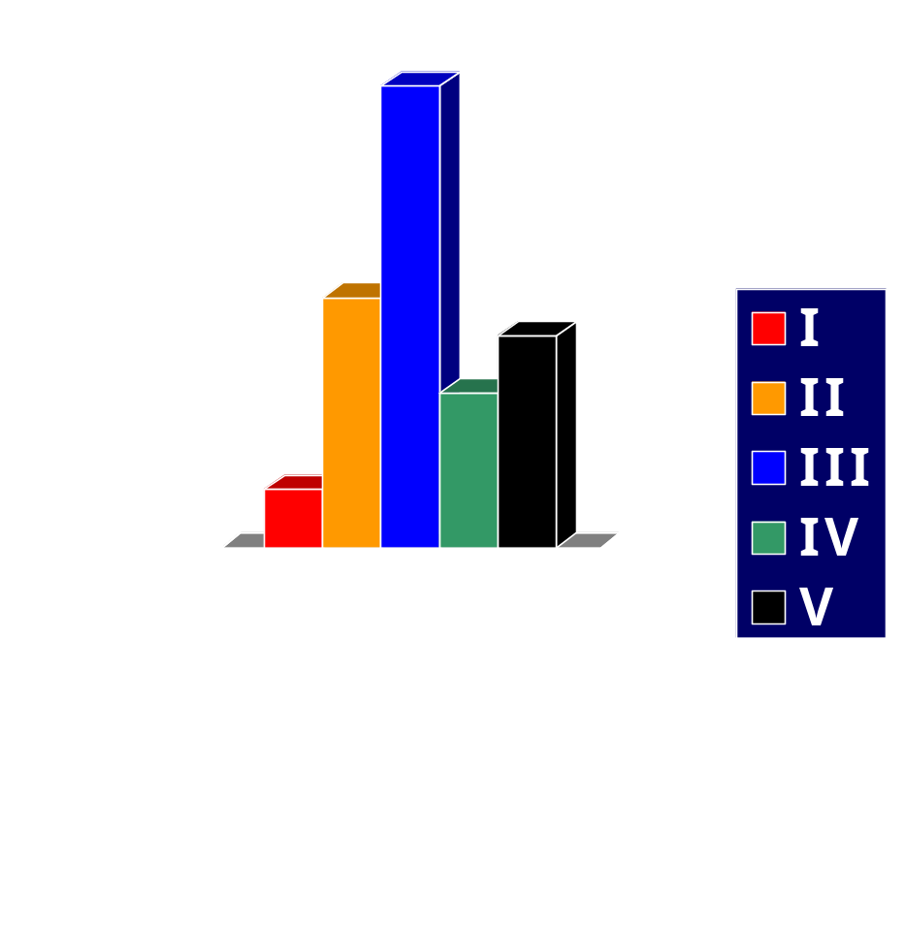
Highway Diesel Fuel
Availability in 2006
Diesel Fuel Refining under the Highway Diesel FRM
  Refineries produce either 100% 15 ppm S diesel fuel (invest) or 100% 500 ppm S diesel fuel (purchase credits)
  PADD-by-PADD evaluation of refineries’ proximity to each other, pipelines, terminals, & other major fuel consuming markets
PADD

Slide 15
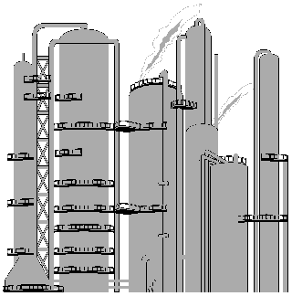
Refinery Modifications to Produce 15 ppm Diesel Fuel
Second reactor
  Increase residence time
  Possibly counter-current flow or new second stage
More active catalysts
Greater hydrogen purity
Possibly higher pressure

Slide 16
Refining Technology Announcements
Phillips S Zorb
  commercial unit at the Borger refinery scheduled for start-up in 2004
  could reduce costs of meeting 15 ppm cap by roughly 25%
UNIPURE, SulphCo, Petrostar
  mild temperature and pressure
  oxidative process
  does not require hydrogen

Slide 17
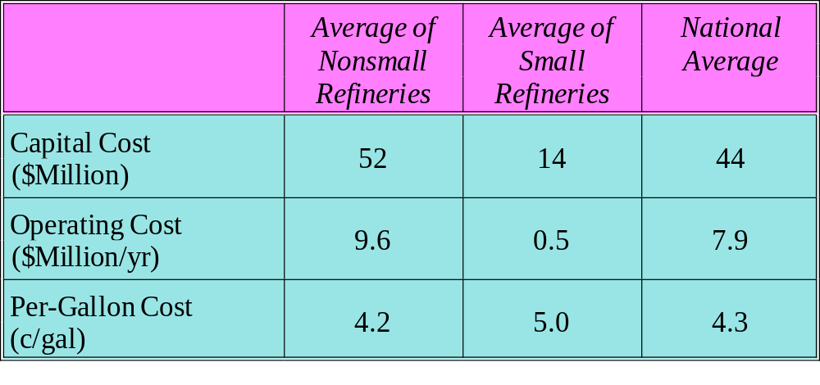
Per-Refinery Capital, Operating, &
Per-Gallon Cost to Meet 15 ppm S Cap
Assumption: 80% revamped units, 20% grassroots units.

Slide 18
Cost of Fuel Change
Refining cost 4.3 ¢/gal
Distribution system cost 0.5
Lubricity additive 0.2
Net: 5 ¢/gal
Net consumer cost ~4 ¢/gal
(considering the ~1 ¢/gal maintenance savings provided by the cleaner fuel)

Slide 19
Interaction with Other Programs
Capital Procurement
Design & Construction Services
  front-end designers
  detailed designers
  construction workers

Slide 20
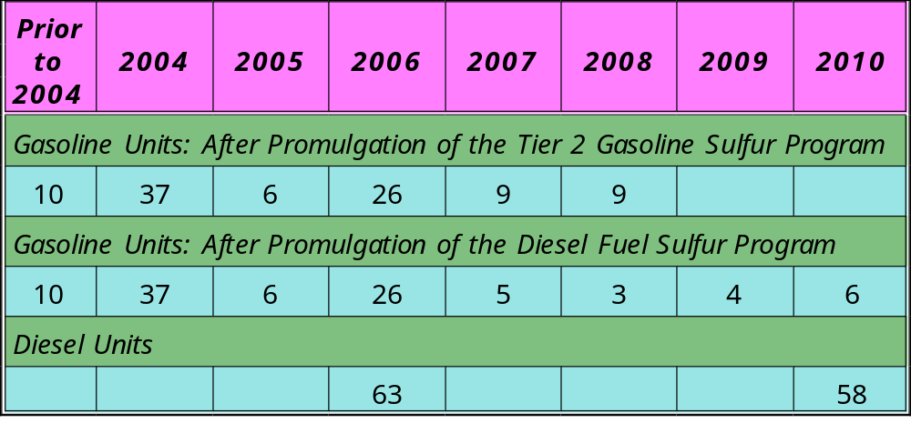
Number of Desulfurization Units Becoming Operational

Slide 21
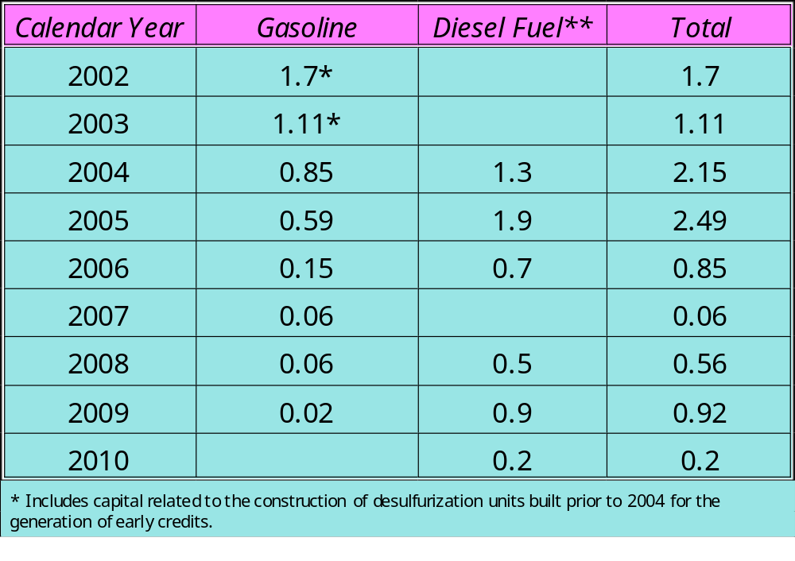
Capital Expenditures for Gasoline & Diesel Fuel Desulfurization

Slide 22
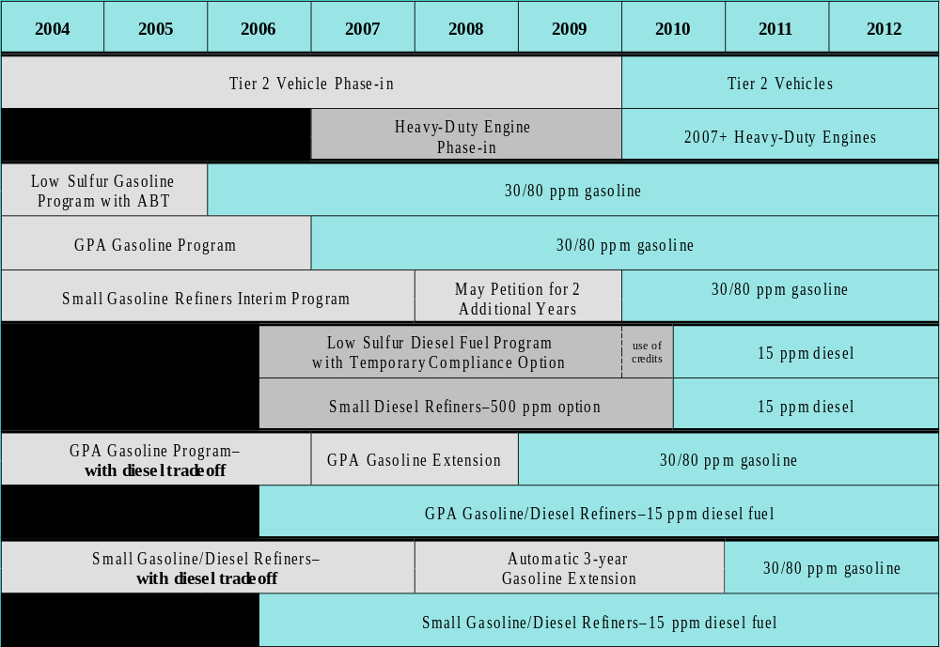
Refiners Compliance Schedule

Slide 23

For More Information...
2007 Heavy-duty Engine and Vehicle
home page:
http://www.epa.gov/otaq/diesel.htm

Slide 24

The (Non)Road Ahead
We recognize the connection between highway and nonroad diesel fuel sulfur control for refiners and distributors
We recognize the lead time issues for refiners as well as engine and equipment manufacturers
We are considering an ANPRM later this year

Slide 25
Thank you

